Slide 1
PROJECT OVERVIEW

Slide 2
DEDICATED SERVER ON VIRTUAL PRIVATE NETWORK

Slide 3
PROJECT GOAL

Slide 4
To Manage company Automation
Easy to use
Scope of the project is user can process the data from remote place
Rapid processing
Effective managerial control over different system in a corporate set up
Cost saving
Reduce Man-Power
Any time Service available

Slide 5
DESCRIPTION

Slide 6
SYNOPSIS
INTRODUCTION AND OBJECTIVES OF THE PROJECT
The objective of my project is to manage the company automation.
The scope of the project is user can process the data from remote place.
So any one who can access the data if he/she is working in a concern, but there is some authorization to do process because of security.
By using the system, the end user i.e. the client can view the process status for their projects.

Slide 7
So the clients don’t want to go the particular company, they can see the information from remote place.
By implementing the software, CMS could save A vast amount of effort and money in the long run.
The most important contribution that the project would render is that the manpower that could be redeployed more efficiently for some other purpose.

Slide 8
AUTHORIZED USER AREA
The modules are restricted to certain user areas. The access list consists only of
Administrator
Marketing Manager
Faculty

Slide 9
Administrator
Administrator has the rights to access entire module list.
Admin
Marketing
Training
Development

Slide 10
Admin
The Admin module consists of the following sub-modules:
*Office:
Enquiry form
Registration form
Course and Fees details
Salary details
*Staff:
Staff attendance
Batch timing

Slide 11
Enquiry Form
*It contain Details about the Enquiry person
REGISTRATION FORM
*It Maintained the details of the Enquirer
*Who wished to register their name
COURSE AND FEES DETAILS
*It maintained the details about Course&Fees

Slide 12
SALARY DETAILS
*It maintain the salary details of the Staff
STAFF ATTENDANCE
*It maintain the Staff Attendance
Only ADMIN has the rights to maintain the details about Office and staff.
It’s a restricted area.

Slide 13
MARKETING
This module consists of three sub-module.
The Marketing Manager has rights to maintain the following details
*ADD CLIENT
Client can be added to this area
* CLIENT LIST
The added clients are listed ie recorded
in this area.

Slide 14
PLACEMENT LIST
After completing the Training ,the students are Placed to the company through the specified contact person.
Its done by the Marketing Manager.

Slide 15
FACULTY
The Faculty has rights to maintain the
detail about the Training, Project and
Student Attendance.

Slide 16
SYSTEM ANALYSIS
System Analysis is conducted with the following objectives:
Identify the customers need
Evaluate the system concept for feasibility
Perform economic and technical analysis
Allocate function to hardware,software,people,database and other system elements.
Establish cost and schedule constraints.
Create a system definition that forms the foundation for all subsequent engineering work

Slide 17
Existing system
Every organization has several departments. Each department has it’s won set of activities. Departments communicate with each other very often to get important information.
Therefore the departments don’t work isolation in any organization.
Suppose, if the CEO wants to see what is happening in the department, he either has to cll the concerned department head and speak to him or can go to the department directly and see what is happening.
This is a time – consuming process, as a CEO has a lot of work for himself and cannot allot time for the above – mentioned work.
To overcome this problem we go for computerization.

Slide 18
By computerizing, the CEO could just click the links to various departments and could view the information he wanted.
Not only the CEO of the company but also the department heads who want some information from other departments could just click the respective links and could view the information.

Slide 19
PROPOSED SYSTEM
In the existing system everyone can view all the information.
Here there is a chance for leakage of confidential information.
Therefore highly confidential information can be protected by the usage of password.
By this method not all can see all information.
One has to know the password to view confidential information another thing is that the views of the students, project members can be determined by providing another link called ‘Feedback’.
This can be used to know the comments of the students about the training that is provided, the comments of the project members about the resources that are provided for doing and completing the project and also the comments and complaints of the employees in the organization.

Slide 20
TECHNOLOGY USED

Slide 21
BROWSER
Any Web browser’s job is twofold: given a pointer to a piece of information on the Net (a URL)
it has to be able to access that information or operate in someway based on the contents of that pointer for hypertext web documents
This means that the browser must be able to communicate with the web server using the HTTP protocol.
It is deal with formatting and displaying web document. Each web page is file written in a language called HTML (Hyper Text Markup Language)
Browser does?

Slide 22
That includes the text of the page, its structure and links to other documents, images, or other media.
The browser takes the information it gets from the Web server and formats and displays it for the system.
Different browsers may format and display the same file differently, depending on the capabilities of that system and the default layout options for the browser itself.

Slide 23
HTML
HTML defines a set of common styles for Web pages: headings, paragraphs, lists, and tables.
It also defines character styles such as boldface and code examples.
Each element has a name and is contained in what’s called a tag.
The browser has mappings between the names of page elements and actual styles on the screen; for example, headings might be in larger front that the text on the rest of the page.
The browser also wraps all the text so that it fits into the current width of the window.

Slide 24
JAVA SCRIPT
Using JavaScript, one can add functionality to web pages, which in the fast would have demanded access to complex CGI-based programs on a web server.
JavaScript is a user-friendly programming language to create complex web-based applications.
JavaScript is unique in the way in which it integrates itself with the World Wide Web.
Instead of being stored as a separate file-like a CGI Script, JavaScript code is included a part of a standard HTML document, just like any other HTML tags and elements.

Slide 25
Web server
A Web server is the program that runs on a Web site and is responsible for replying to Web browser requests for files.
You need a Web server to publish documents on the web.
On the server side, many different browsers may connect to the same server to get the same information.
The Web server is responsible for handling all these requests.
Web servers do more that just deposit files. They are also responsible for managing form input and for linking forms and browsers with programs such as database running on the server.
Java Development Kit (JDK)(http://www.javasoft.com/products/jdk/1.2)

Slide 26
JAVA SERVLETS
Servlets are small programs that execute on the server side a Web connection.
Servlets dynamically extend the functionality of a Web server. Java Servlet Development
Kit contains the class libraries that you will need to create Servlets.
Java Servlets can be downloaded from http://java.sun.com

Slide 27
Java DataBase Connectivity(JDBC)
A Database is a collection of data that is organized so that it may easily search and updated.
A Relational database is organized into tables that consist of rows and columns.
A database server is a software program that manages databases, keeps them organized and provides shared access to them.
Many database servers use vendor specific protocols. However Microsoft has established a common standard for communicating with database clients, called Open Database Connectivity (ODBC).

Slide 28
Java Database Connectivity (JDBC) is a part of Java Enterprise API from Sun Microsystems Inc.
JDBC is the first standardized effort to integrate relational databases with Java programs.

Slide 29
RESOURCE REQUIREMENTS
HARDWARE REQUIREMENTS:
Process speed
Ram
Modem
Port
Monitor
166 MHZ or above
32 MB
56 kbps
Serial port for modem
14” Color Monitor

Slide 30
FOR WEB SERVER
Process Speed
Ram
Hard disk drive
Modem
Port
Monitor
450 MHZ or above
128 MB or above
2 GB or above
56 Kbps
Serial port for modem
14” Color Monitor

Slide 31
SOFTWARE REQUIREMENTS
Operating system
Client side
Server side
Interfaces, tools used
Windows 2000/NT
HTML, Java Script
Java, JSP, JDK, JDBC, Bea Weblogic Server 6-1
Browsers like Internet Explorer, Netscape and Navigator.

Slide 32
CLASSIFICATION

Slide 33
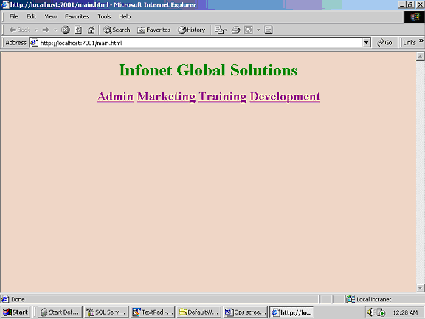
It’s a Main form
It contain four module

Slide 34
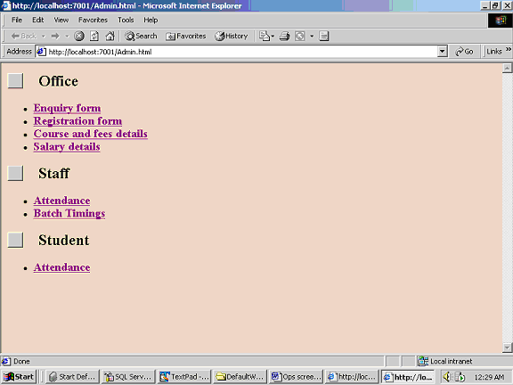
Form defines three sub-modules of ADMIN

Slide 35
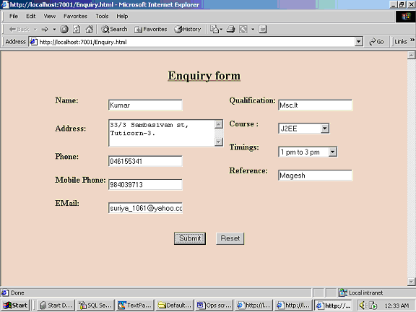
It contains the details of ENQUIRY PERSON

Slide 36
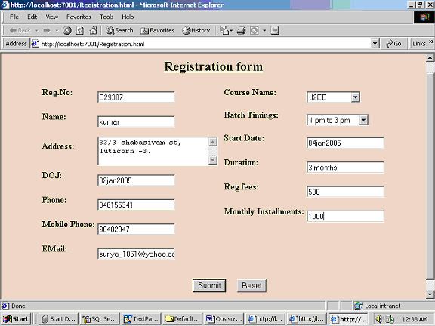
It represent
The Details about
The Person who gets Registered

Slide 37
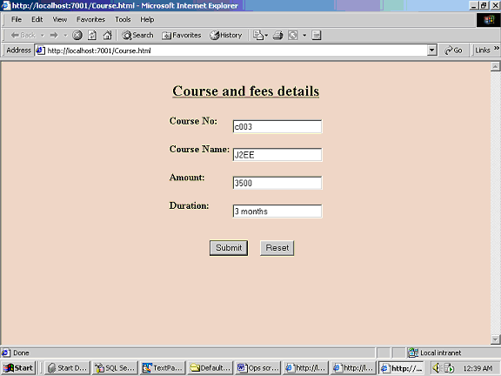
It contains the Details about
The Course & Fees

Slide 38
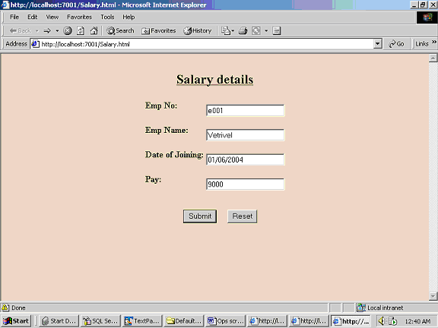
Form points about
Salary details of
The Staff

Slide 39
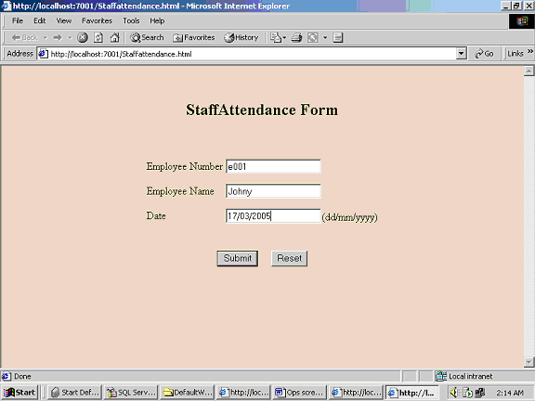
*Its denote the
Attendances of Staff
*Its maintained by the Admin

